Slide 1
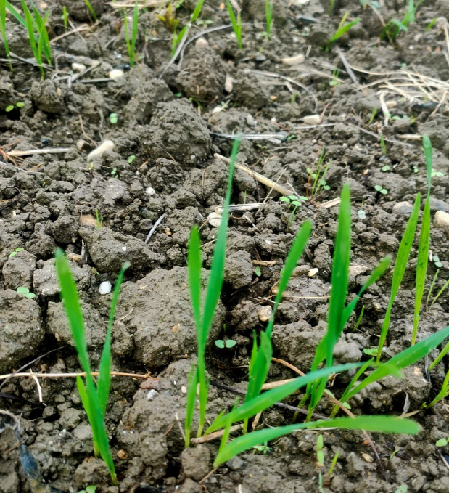
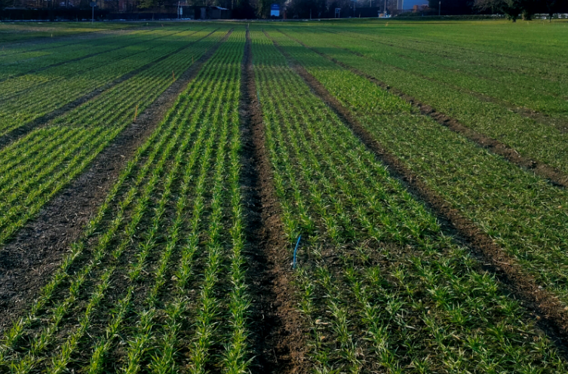
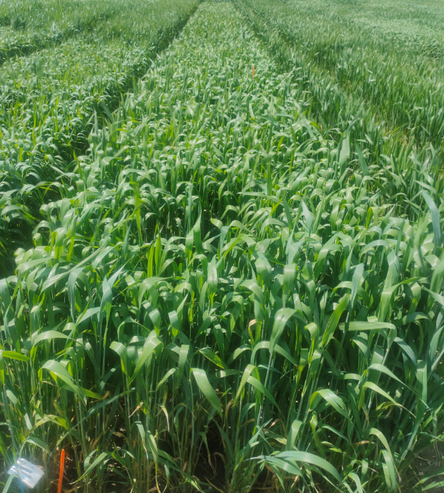
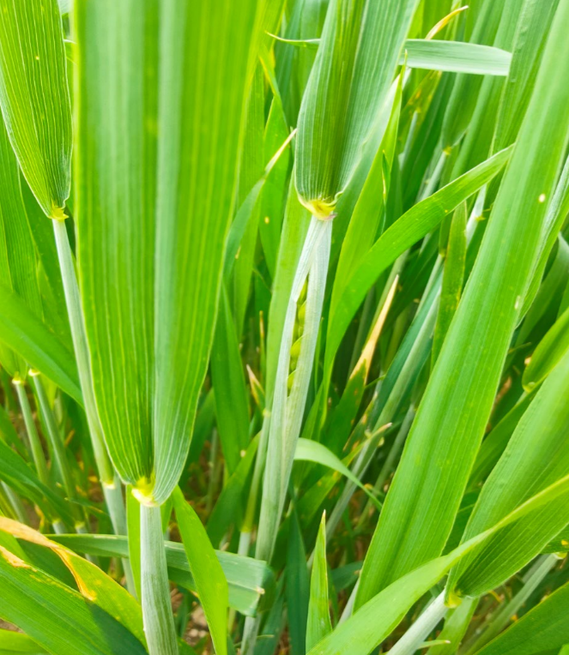
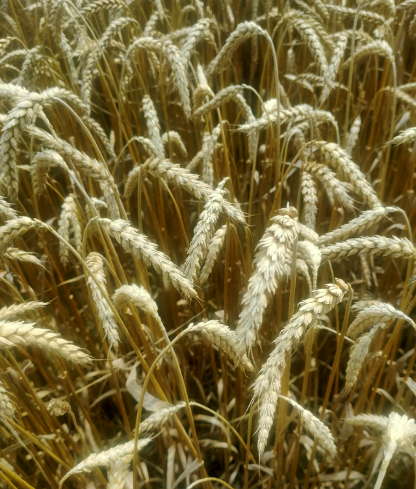
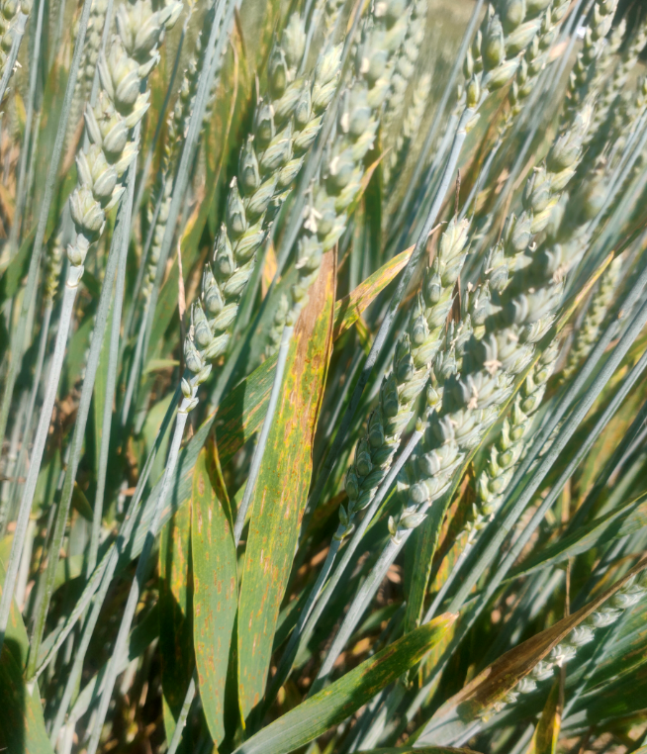
M3-Machine learning on hyperspectral data - wheat trial
Nicolas Vuille-dit-Bille

Slide 2
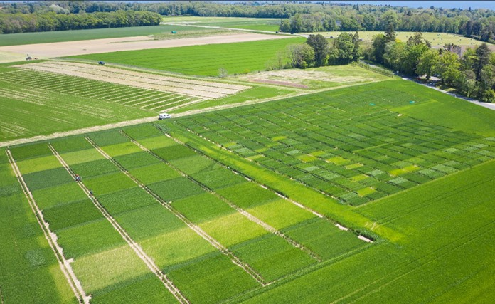
Agroscope: swiss federal institute for agricultural research
Group:
Cultivation Techniques and Varieties in Arable Farming
Team:
35 People
Domains of research:
Agronomy
Crop science
Main areas of work:
Characterization of genotypes of field crops
Improvement of management practices of field crops
Crop species:
Winter cereals (wheat, barley, oat, …)
Maize
Potato and Sugar beet
Oil crops and grain legumes
Minor crops (e.g. Quinoa, Amaranth)

Slide 3
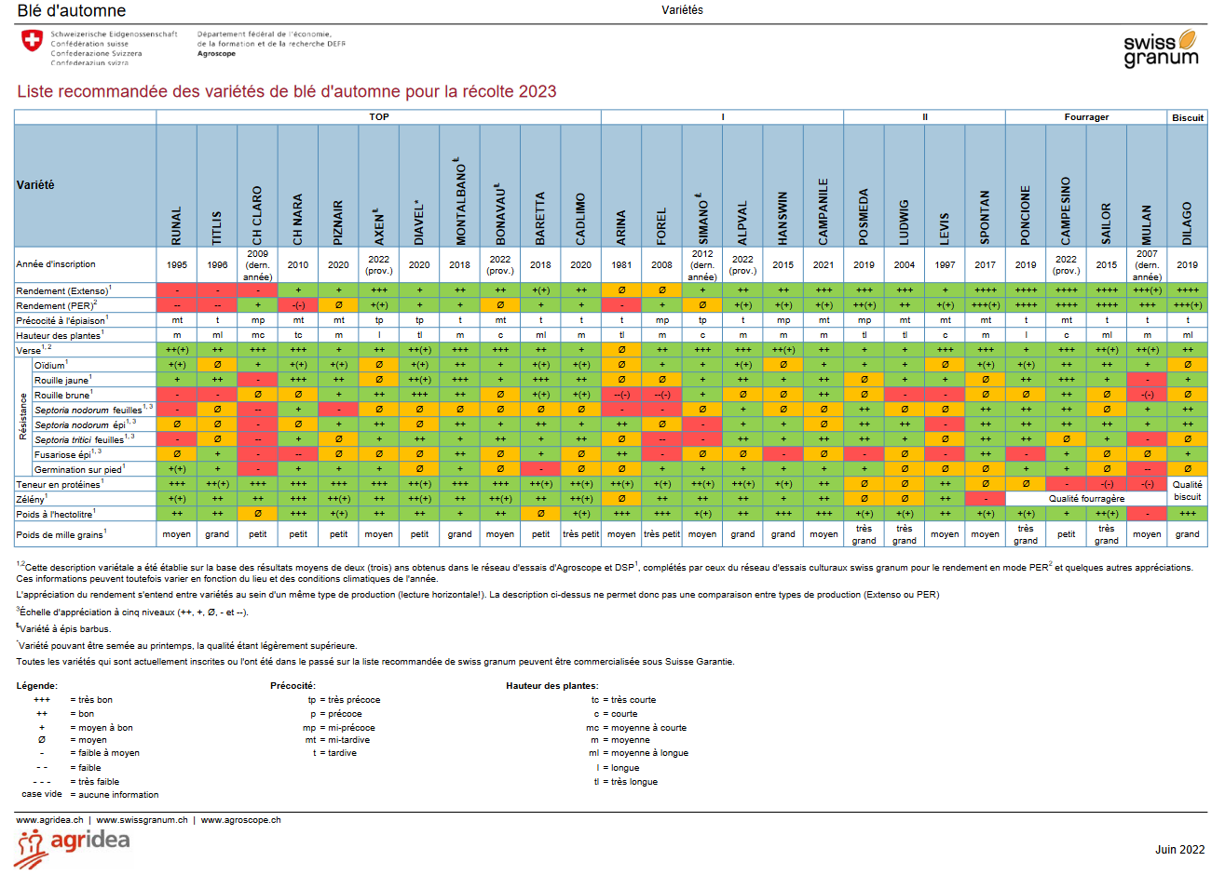
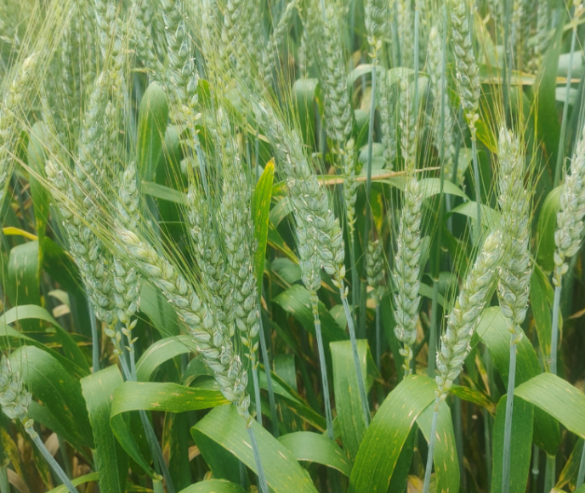
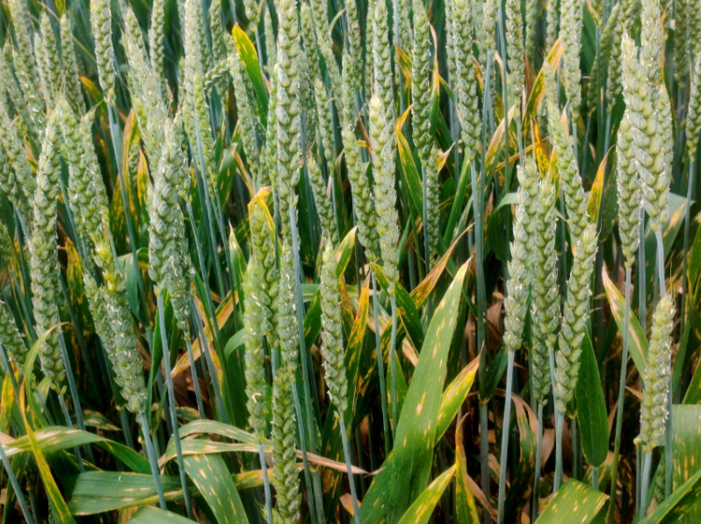
Variety trial context
Winter wheat varieties are tested on different experimental fields across Switzerland with different modality (low vs high inputs)
Each year, winter wheat varieties performance are reported and recommended to farmers according to a list
Challenge: not easy to estimate and understand accurately specific varieties response to specific environment linked to abiotic and biotic stresses (uncontrolled factors on the field)

Slide 4
Case study: winter wheat trial with 2 treatments over 2 years on 3 sites
5 winter wheat varieties
2 years: 2021 to 2022
3 sites: Changins, Goumoens and Reckenholz
Case study context: study variety response to different N treatment
Find variety that are performing well also under limited available N in order to reduce N fertilization (economic and environmental cost)
3 main treatments: none, reduced and conventional
Measurement to estimate varieties performance:
Grain yield
Straw yield
Grain protein
Other physiological parameters (harvest index, leaf area index, chlorophyll content, canopy cover…)
Hyperspectral data

Slide 5
Case study: field experimental design

Slide 6
Case study: variety x N treatments
Treatment ID | Variety | N treatment | Total N applied | N rate
1 | CH Claro | N0 | 0 kgN/ha-1 | 0-0-0
2 | CH Claro | N1 | 80 kgN/ha-1 | 20-40-20
3 | CH Claro | N2 | 80 kgN/ha-1 | 20-60-0
4 | CH Claro | N3 | 160 kgN/ha-1 | 40-80-40
5 | CH Claro | N4 | 160 kgN/ha-1 | 40-120-0
6 | CH Nara | N0 | 0 kgN/ha-1 | 0-0-0
7 | CH Nara | N1 | 80 kgN/ha-1 | 20-40-20
8 | CH Nara | N2 | 80 kgN/ha-1 | 20-60-0
9 | CH Nara | N3 | 160 kgN/ha-1 | 40-80-40
10 | CH Nara | N4 | 160 kgN/ha-1 | 40-120-0
11 | CH Camedo | N0 | 0 kgN/ha-1 | 0-0-0
12 | CH Camedo | N1 | 80 kgN/ha-1 | 20-40-20
13 | CH Camedo | N2 | 80 kgN/ha-1 | 20-60-0
14 | CH Camedo | N3 | 160 kgN/ha-1 | 40-80-40
15 | CH Camedo | N4 | 160 kgN/ha-1 | 40-120-0
16 | Montalbano | N0 | 0 kgN/ha-1 | 0-0-0
17 | Montalbano | N1 | 80 kgN/ha-1 | 20-40-20
18 | Montalbano | N2 | 80 kgN/ha-1 | 20-60-0
19 | Montalbano | N3 | 160 kgN/ha-1 | 40-80-40
20 | Montalbano | N4 | 160 kgN/ha-1 | 40-120-0
21 | Runal | N0 | 0 kgN/ha-1 | 0-0-0
22 | Runal | N1 | 80 kgN/ha-1 | 20-40-20
23 | Runal | N2 | 80 kgN/ha-1 | 20-60-0
24 | Runal | N3 | 160 kgN/ha-1 | 40-80-40
25 | Runal | N4 | 160 kgN/ha-1 | 40-120-0

Slide 7
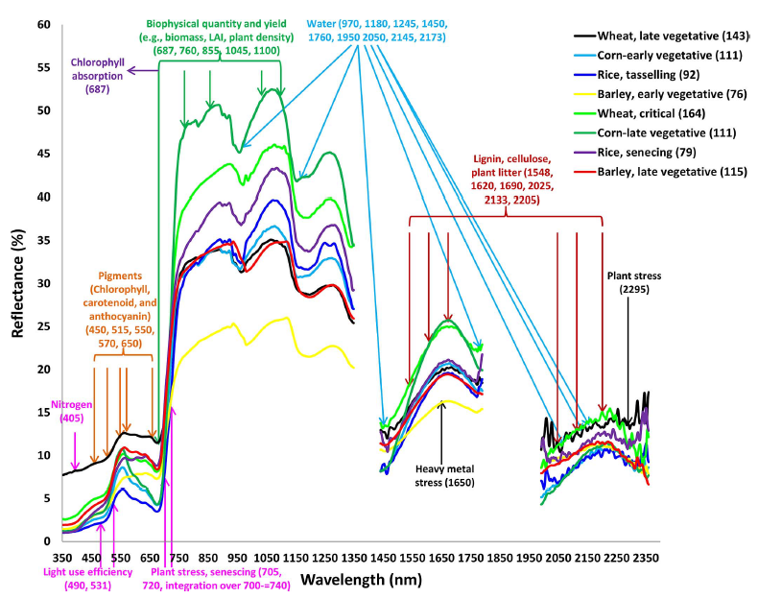
Hyperspectral data: theory
Thenkabail, P. S., Mariotto, I., Gumma, M. K., Middleton, E. M., Landis, D. R., & Huemmrich, K. F. (2013). Selection of hyperspectral narrowbands (HNBs) and composition of hyperspectral twoband vegetation indices (HVIs) for biophysical characterization and discrimination of crop types using field reflectance and Hyperion/EO-1 data. IEEE Journal of Selected Topics in Applied Earth Observations and Remote Sensing, 6(2), 427‑439. https://doi.org/10.1109/JSTARS.2013.2252601

Slide 8
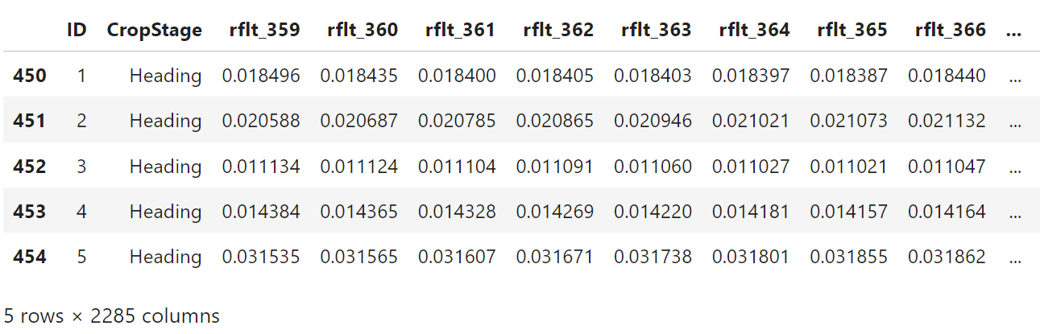
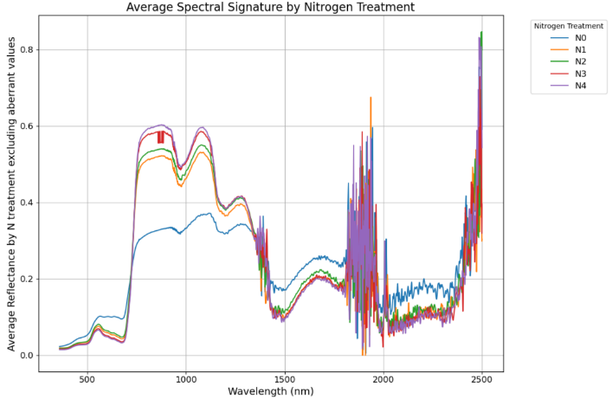
Hyperspectral data collection
Time series data corresponding to key crop growth stage
2 years: 2021-2022
3 sites: Changins, Goumoens and Reckenholz

Slide 9
Hyperspectral data cleaning
Remove bands with aberrant values : <0 or >1
Remove bands with 0 value

Slide 10
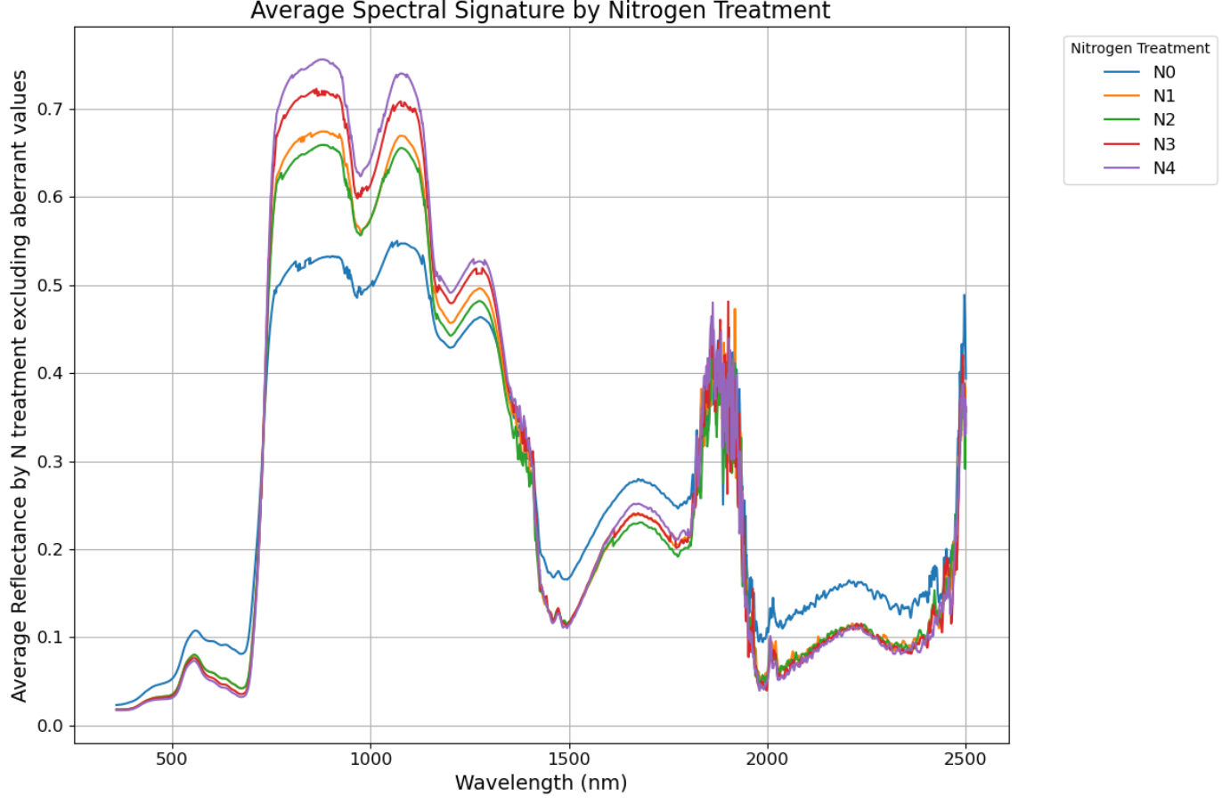
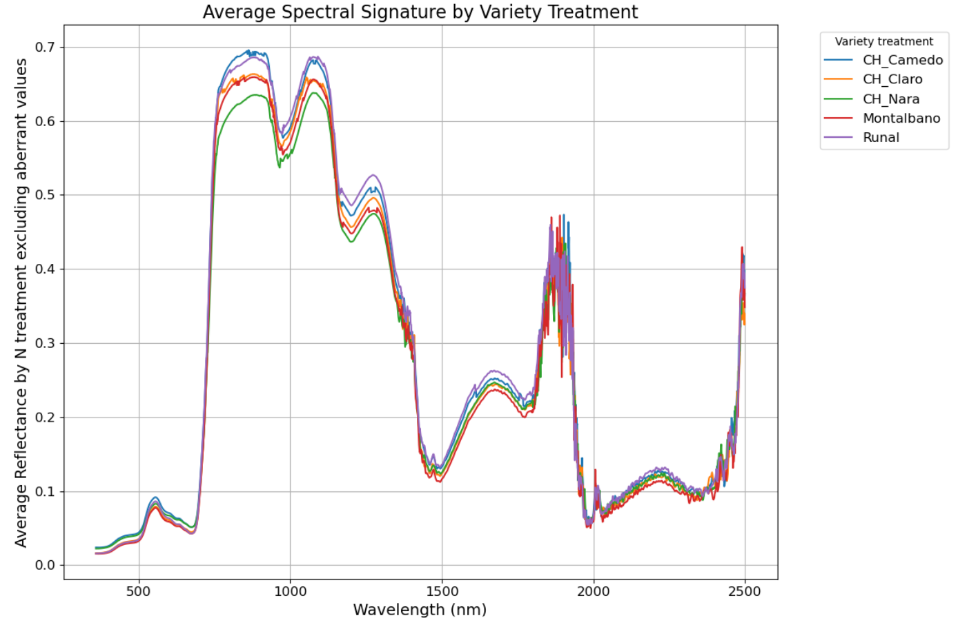
Average of spectral signature by treatments at heading
Nitrogen treatment
Variety treatment

Slide 11
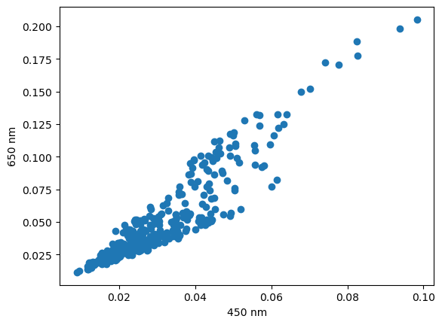
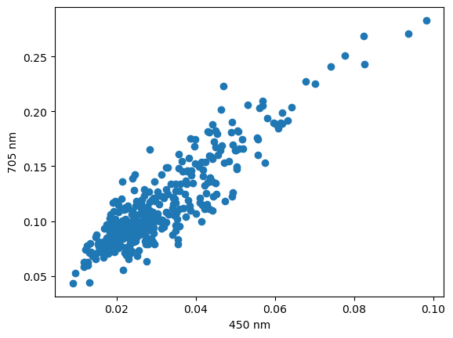
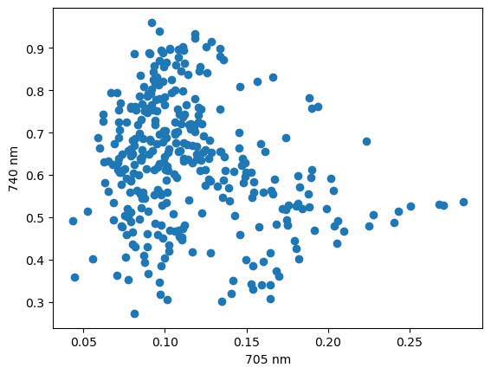
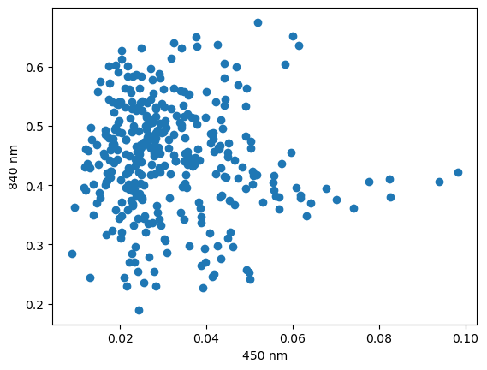
Hyperspectral: highly intercorrelated

Slide 12
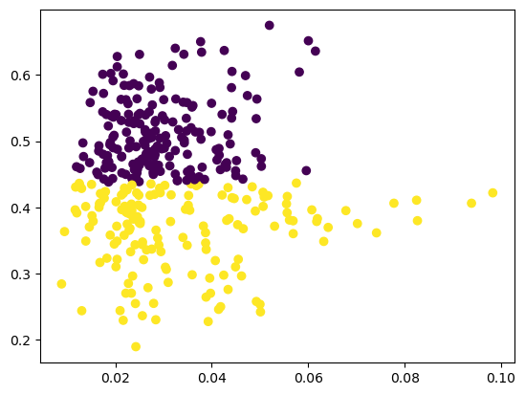
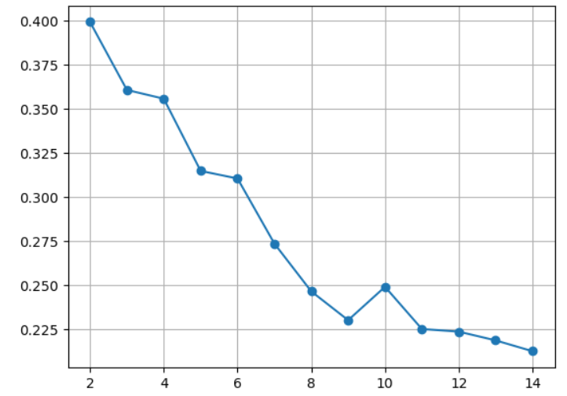
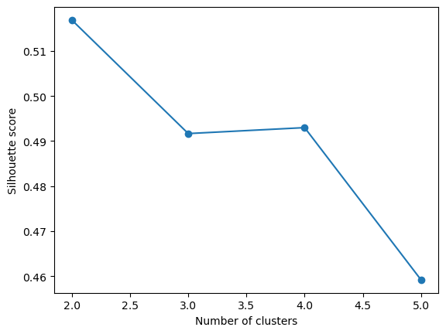
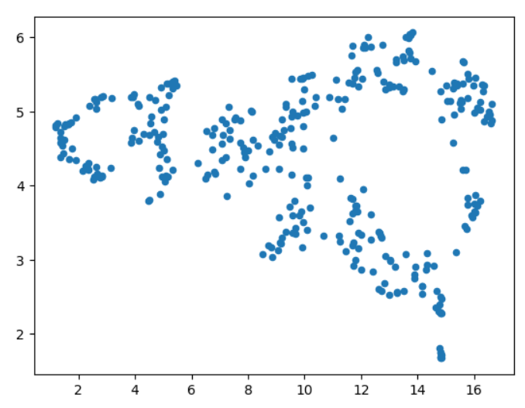
Data exploration: clustering (K-means) and umap
2D
High dimensional
840 nm
450 nm

Slide 13
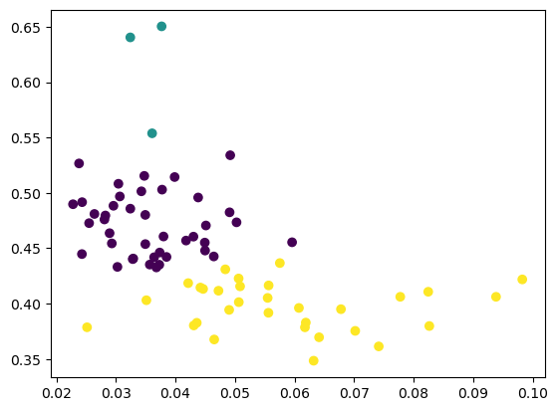
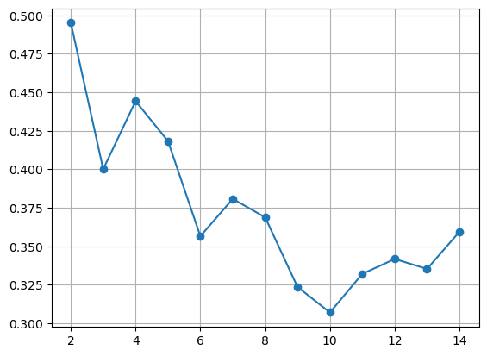
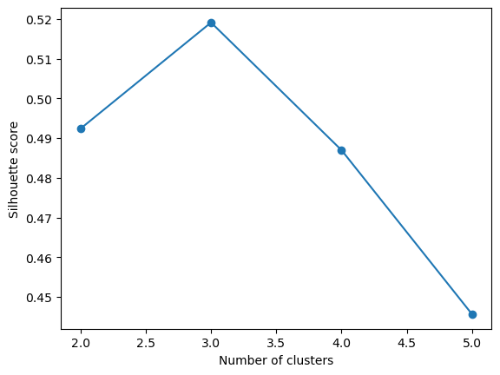
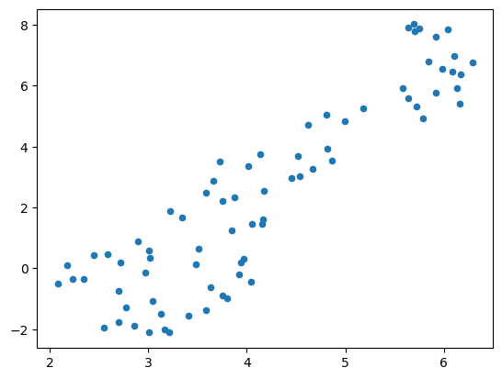
Data exploration: clustering (K-means) and umap – Focusing on Changins in 2022
2D
High dimensional
840 nm
450 nm

Slide 14
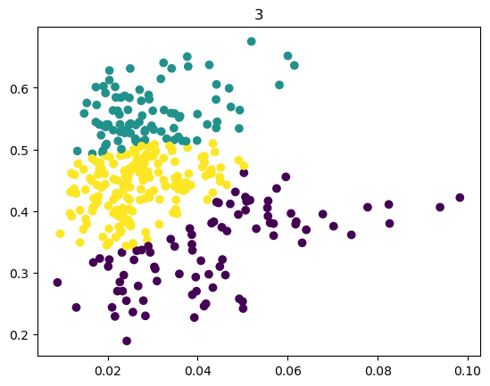
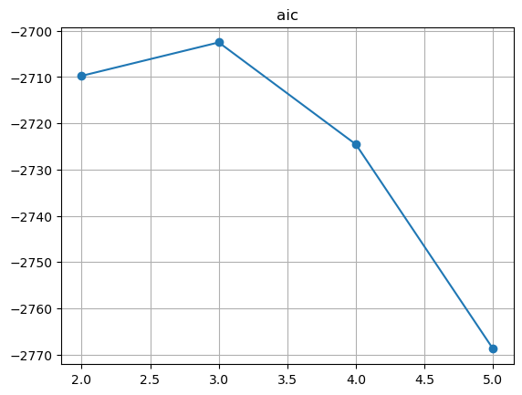
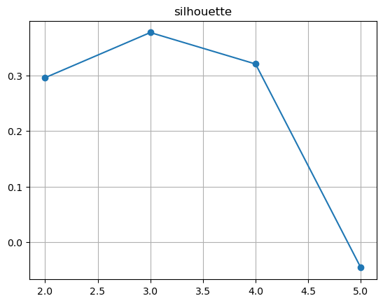
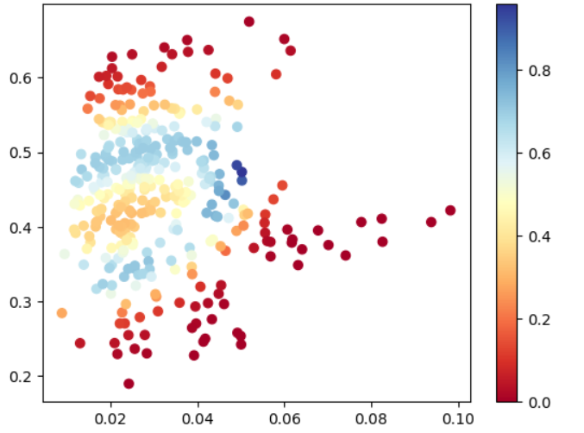
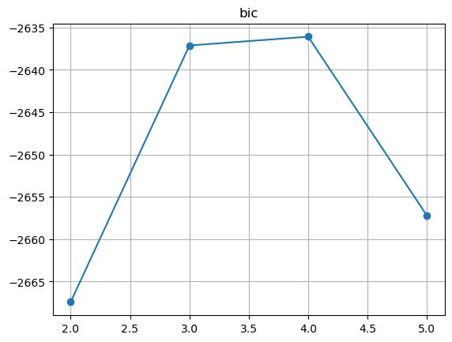
Data exploration: Gaussian mixtures (soft clustering)
840 nm
450 nm
Cluster uncertainty
Take into account more complex cluster shapes than circular (K-means)

Slide 15
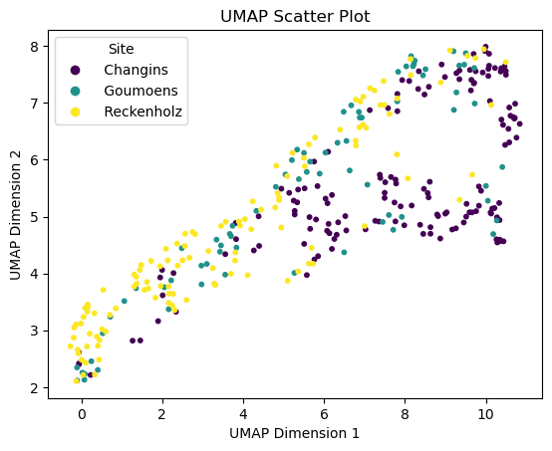
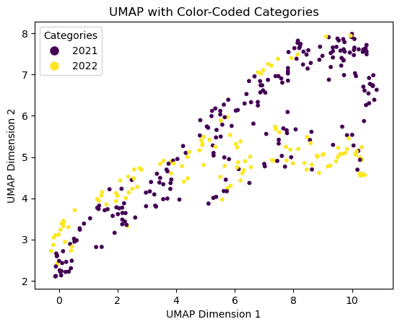
Data exploration: umap

Slide 16
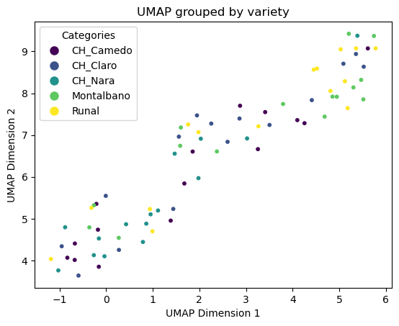
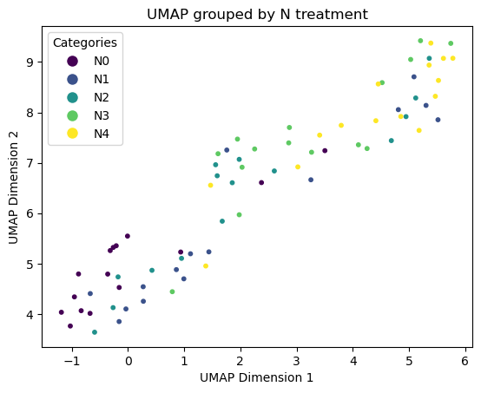
Data exploration: umap-focus on Changins 2022

Slide 17
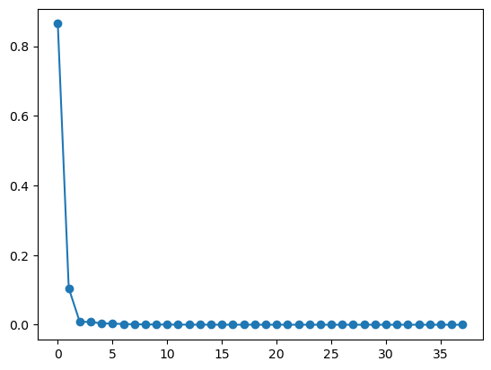
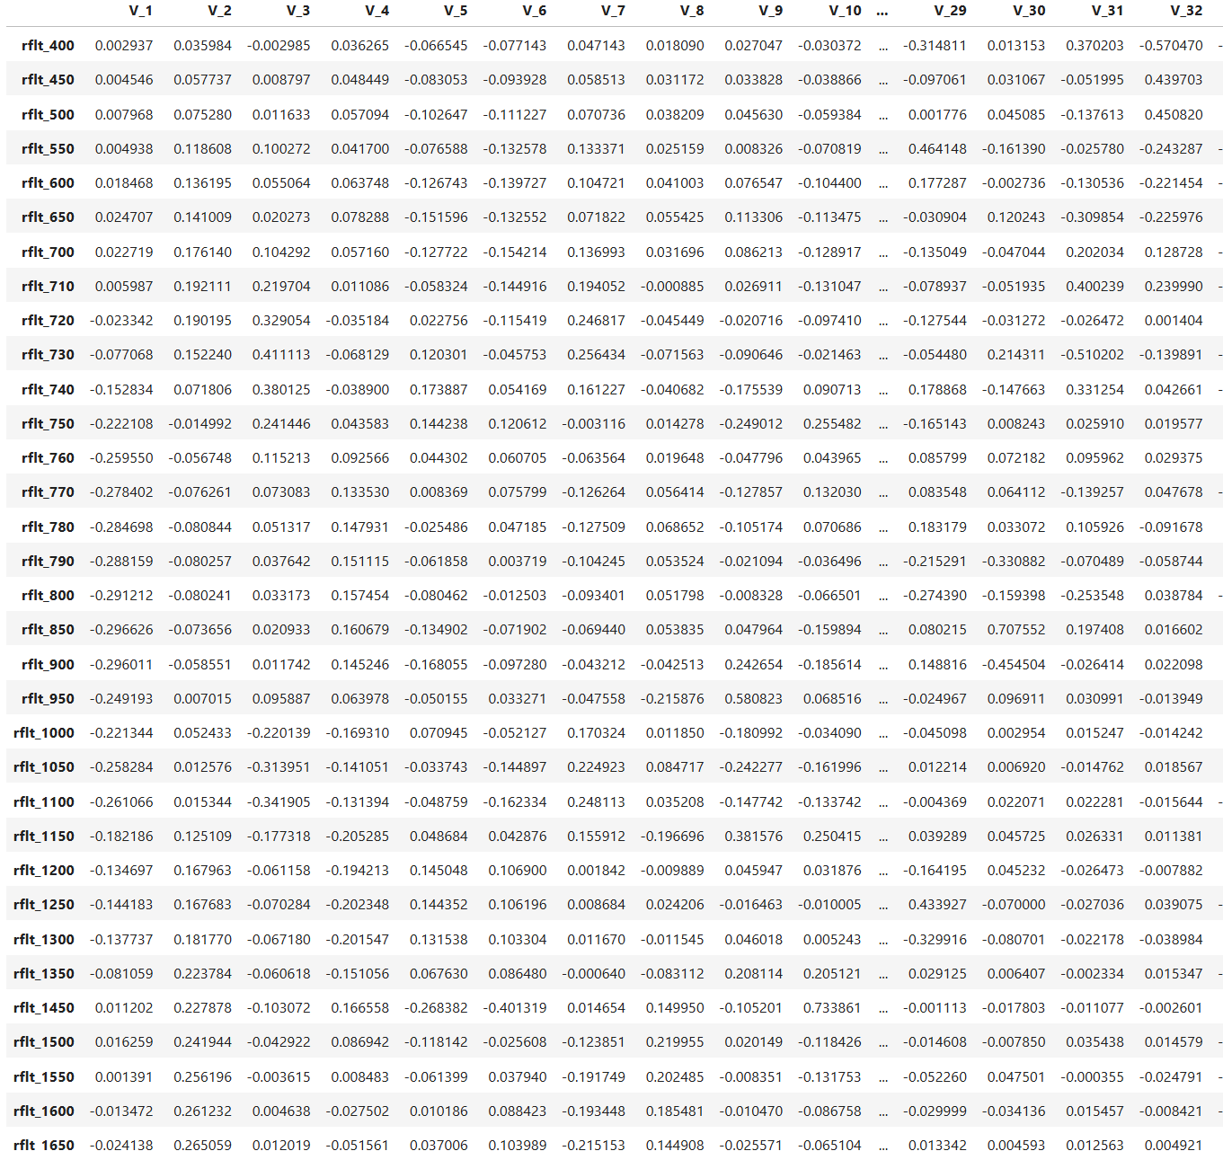
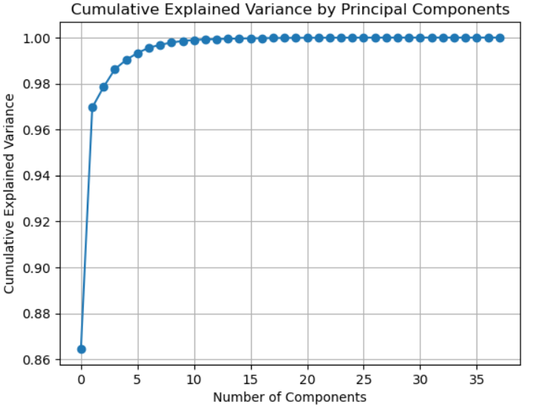
Data exploration: PCA
Most of the variance is explained by the first principal components

Slide 18
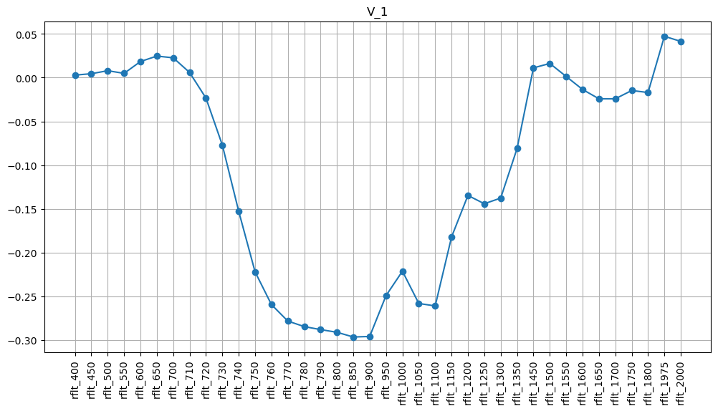
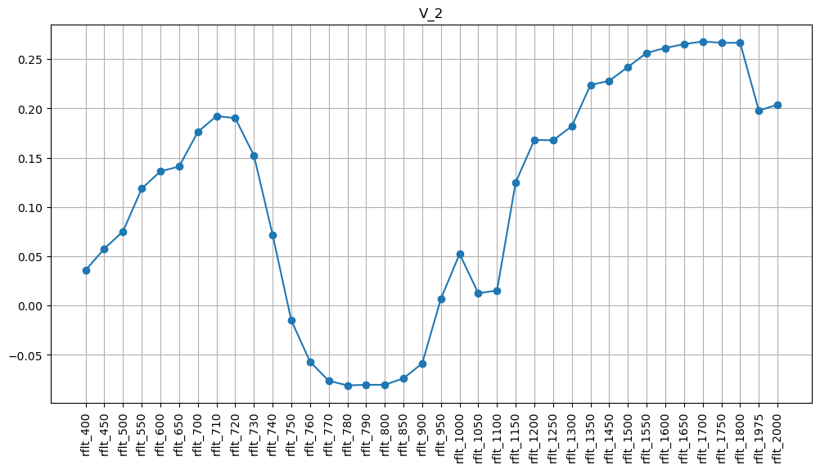
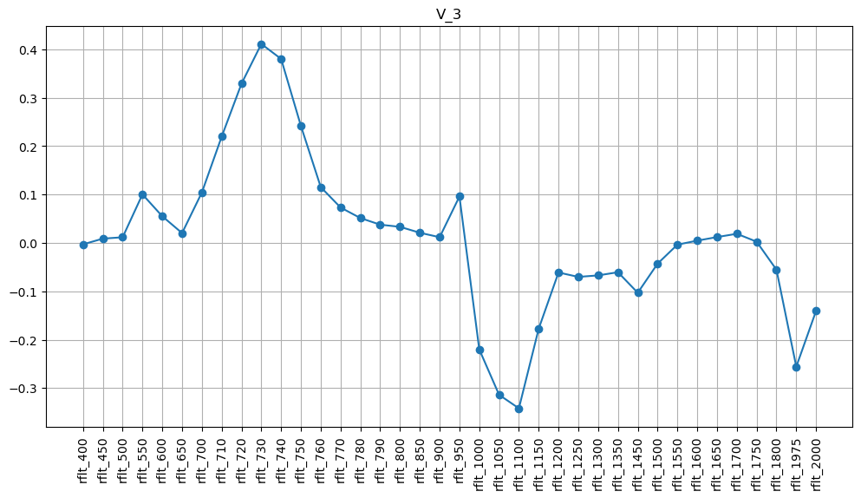
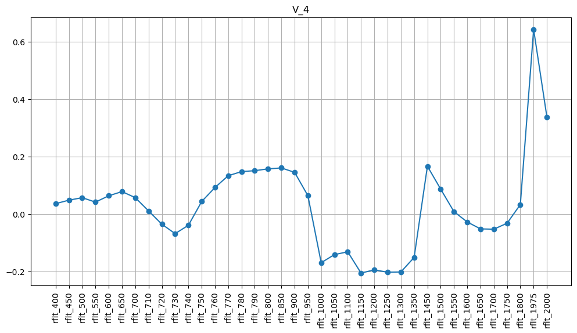
Data exploration: PCA
V1:
900 nm
850 nm
800 nm
790 nm
780 nm
770 nm
V2:
700 nm
710 nm
720 nm
1800 nm
1550 nm
38 features at the beginning → 17 features selected
V3:
730 nm
740 nm
1050 nm
1100 nm
V4:
1975 nm
2000 nm
Notes:
pycahe22

Slide 19
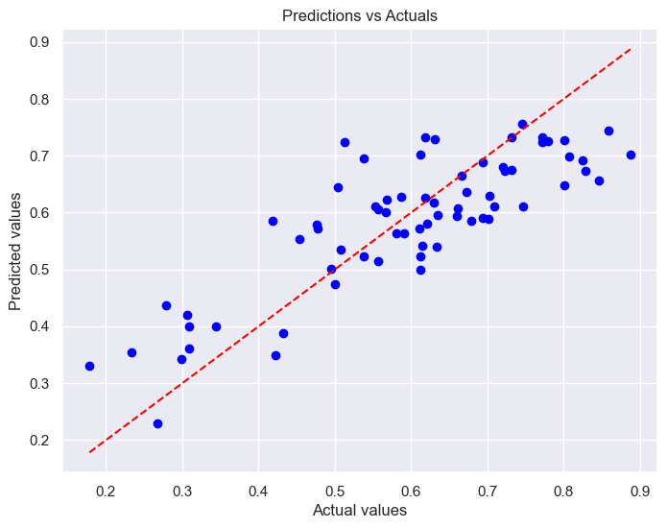
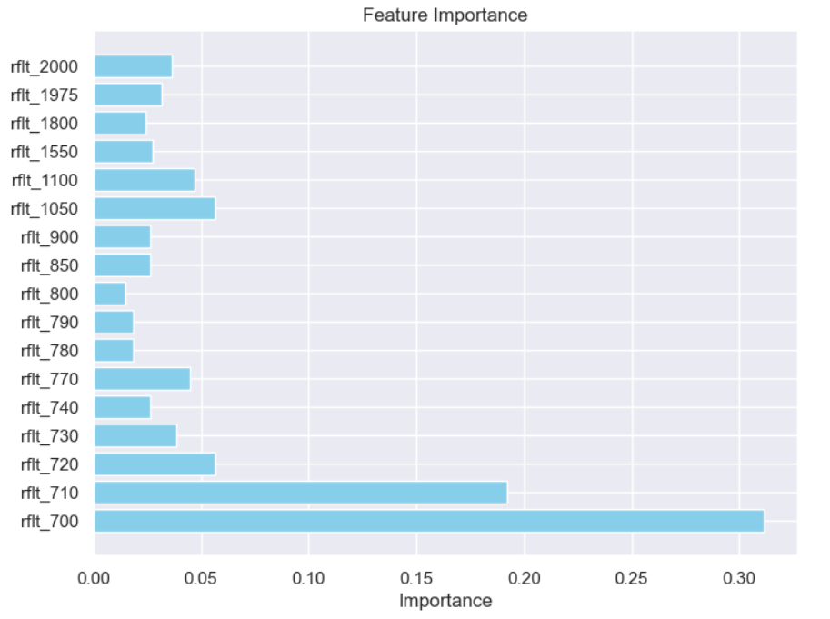
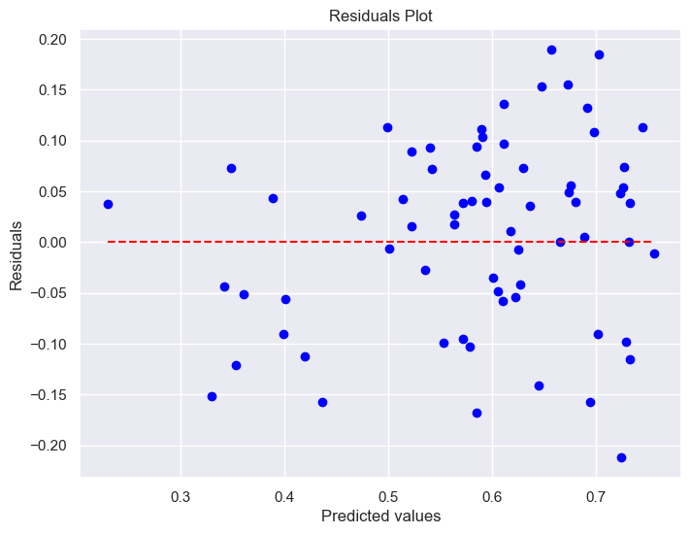
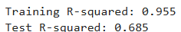
Random forest model with selected features

Slide 20
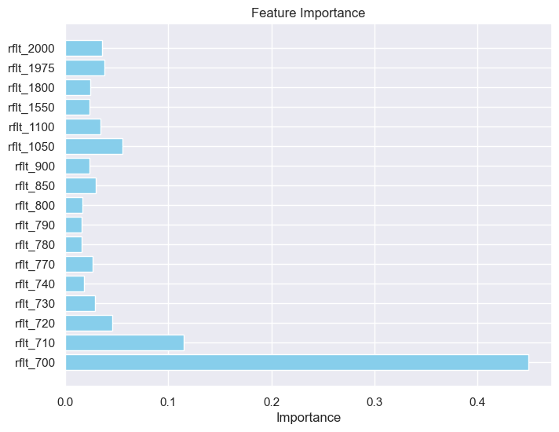
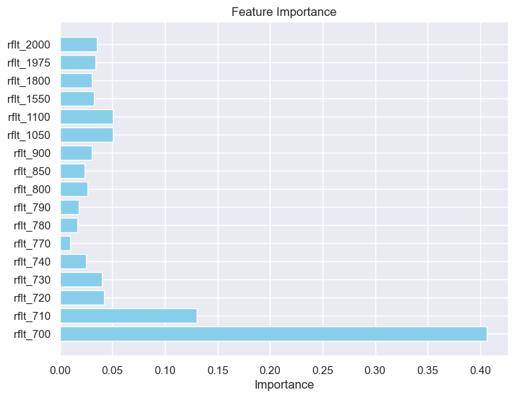
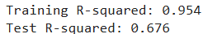



Random forest model with selected features: improvement tests
Splitting train and test sets according to years or sites
Reducing the tree depth (max_depth) and increasing the number of trees (n_estimators)
Sites
Years

Slide 21
Conclusion
Field data can be noisy:
Hyperspectral data is highly sensitive to weather conditions
Promising results in data exploration (PCA):
Highlighted the importance of red-edge bands between 700 to 800 nm to be able to characterize winter wheat performance
Promising results in random forest:
Highlighted the 700-710 nm part of the spectrum to explain grain yield differences
In theory it is linked to Nitrogen (N) chlorophyll content
Low performance in the test set compared to the training set:
Overfitting?
Other agronomic parameter could be analysed to link to hyperspectral data
Straw yield (positively correlated with grain yield)
Harvest index (indicates the ratio of grain on total plant weight (grain + straw)
Protein in grain (negatively correlated with grain yield)
Plant height (positively correlated with grain and straw yield; lodging effect)
Disease (can explain unexpected low yield)

Slide 22

Thank you for your attention
Nicolas Vuille-dit-Bille nicolas.vuille-dit-bille@agroscope.admin.ch
Agroscope good food, healthy environment
www.agroscope.admin.ch

